Slide 1


Introduction to Phishing
Welcome to this presentation on phishing. Phishing is a type of cybercrime that involves using deceptive emails or websites to trick users into giving up sensitive information, like passwords or credit card details.

Slide 2

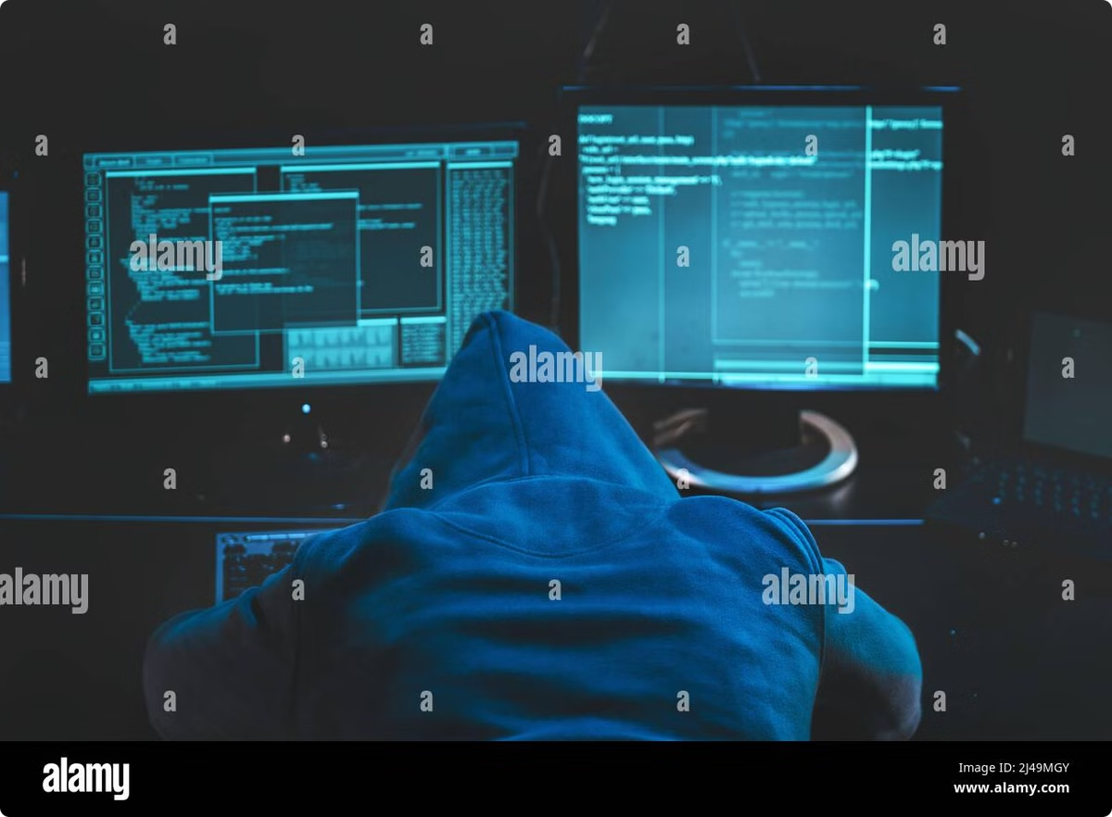
What is Phishing?
Phishing is a type of social engineering attack where attackers try to trick users into revealing sensitive information by pretending to be a trustworthy entity.
Deception
Information Gathering
Attackers use emails or websites that look legitimate to fool users.
The goal is to obtain confidential data such as login credentials, credit card numbers, and personal information.
Financial Gain
Attackers can use stolen information for fraudulent activities, such as online shopping or identity theft.

Slide 3
Types of Phishing Attacks
Phishing attacks come in various forms, targeting users with different tactics.
Email Phishing
Spear Phishing
Smishing
The most common type, where attackers send emails disguised as legitimate communications from banks, businesses, or government agencies.
Highly targeted attacks that use personalized information to make the phishing attempt more convincing.
Phishing attacks that utilize text messages, often impersonating banks or other financial institutions.

Slide 4

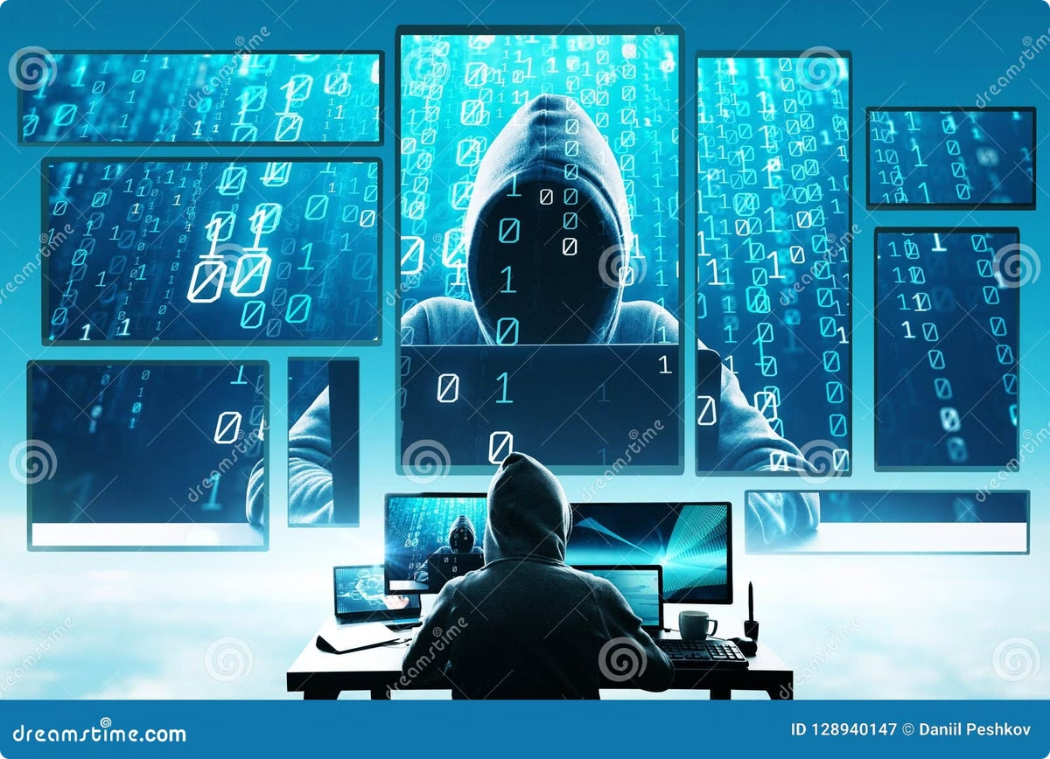
Phishing Techniques
Attackers use a variety of techniques to make phishing attempts more believable.
1
Urgency
2
Social Proof
Creating a sense of urgency, such as a limited-time offer or a security breach, to pressure users into acting quickly.
Using fake testimonials, reviews, or endorsements to build trust and legitimacy.
3
Fear and Intimidation
Creating a sense of fear or intimidation to manipulate users into taking action.

Slide 5


Consequences of Phishing
Phishing attacks can have serious consequences for individuals and organizations.
Financial Loss
Stolen credit card information, unauthorized transactions, and identity theft.
Data Breaches
Compromised accounts, sensitive information exposed, and reputational damage.
Legal Issues
Potential legal ramifications for individuals and organizations involved in phishing scams.

Slide 6






Protecting Against Phishing
It's essential to take proactive measures to protect yourself from phishing attacks.
Be Vigilant
Be cautious about suspicious emails, links, and attachments.
Verify Information
Double-check the sender's address and website URLs.
Use Strong Passwords
Create complex passwords and avoid reusing them across multiple accounts.
Enable Two-Factor Authentication
Add an extra layer of security to your accounts by requiring a second verification step.

Slide 7

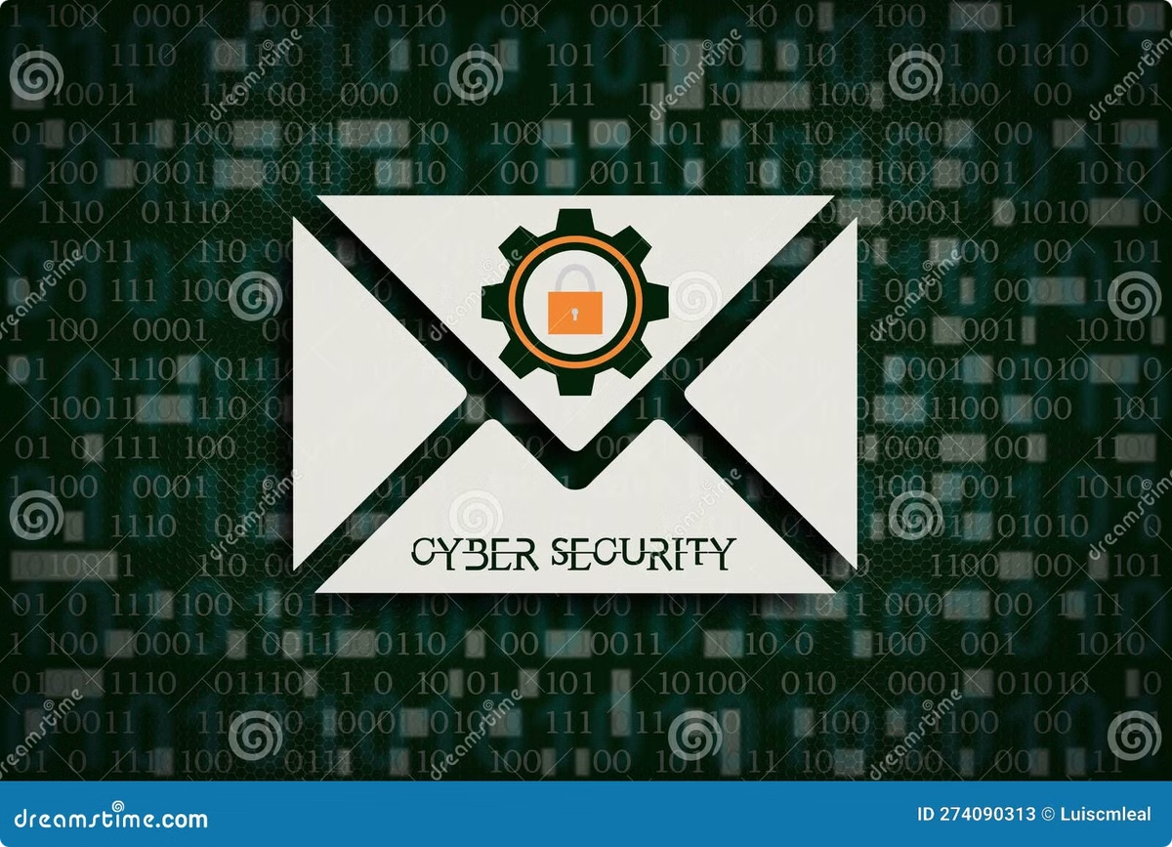




Recognizing Phishing Attempts
Be aware of common phishing indicators that can help you identify and avoid these attacks.
Suspicious Links
Urgency and Scarcity
URLs that appear misspelled or redirect to unexpected websites.
Emails that create a sense of urgency or offer limited-time deals.
Fake Login Pages
Grammar and Spelling Errors
Websites that look like legitimate login pages but are actually designed to steal credentials.
Phishing emails often contain grammatical errors or poor spelling.

Slide 8

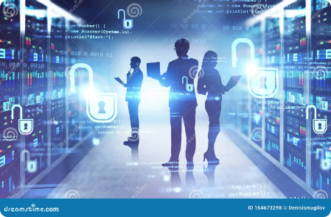
Conclusion and Takeaways
Phishing is a serious threat, but by understanding its tactics and implementing protective measures, you can significantly reduce your risk of becoming a victim.
1
Stay Informed
2
Be Critical
3
Report Suspicious Activity
Keep up to date with the latest phishing techniques and security best practices.
Think critically before clicking on links or providing information online.
Report phishing attempts to the appropriate authorities to help prevent others from being scammed.

